Slide 1


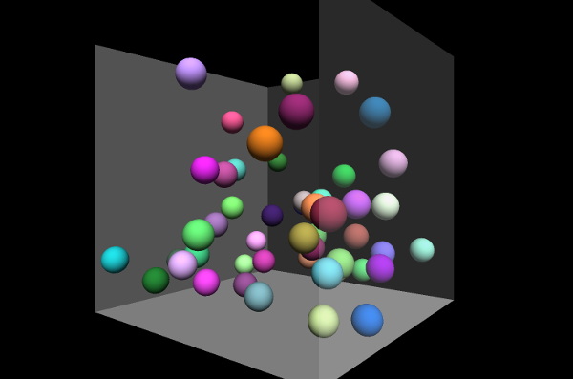
BVRIT HYDERABAD College of Engineering for Women
Department of Computer Science and Engineering
BALLOONS IN A BOX
Team No: 3
P LIKHITA VARMA (21WH1A0578)
KPM SRI MANASWI (21WH1A0575)
B HEMALATHA (21WH1A0576)
CH SRI VRINDA (21WH1A0577)
ANIYA AFNAN (21WH1A0579)

Slide 2
AGENDA
Problem Statement
Python Packages
Modules
Functions used from math module
Code
Status of completion
Challenges Faced
References (links, tutorials)

Slide 3
Problem Statement
You are given a rectangular box and a set of points.
Each point represents a position where you might place a balloon.
Center it at the point and inflate the balloon until it touches a side of the box or a previously placed balloon.
The objective is to place balloons in the box in an order
that maximizes the total volume occupied by the balloons.
You are required to calculate the volume within the box that
is not enclosed by the balloons.

Slide 4
Input:
2
0 0 0
10 10 10
3 3 3
7 7 7
0
Output:
Box 1:774
Date 04/02/2023

Slide 5
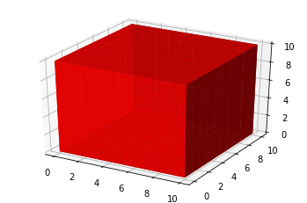
Python Packages
Packages used in the code:
Matplotlib:
It is an amazing visualization library in Python for 2D plots of arrays.
Numpy:
compatible sparse array library that integrates with Dask and SciPy
sparse linear algebra

Slide 6
Module
Modules used in the code:
Math module
math is a built-in module in the Python 3 standard library that provides standard mathematical constants and functions. You can use the math module to perform various mathematical calculations, such as numeric, trigonometric, logarithmic, and exponential calculations.

Slide 7
Functions used from math module:
Pi function:
Pi is defined as the ratio of the circumference to the diameter of a circle and its value is 3.141592653589793.
volume = round(4/3 * math.pi *(r**3))
min function:
The min() function returns the item with the lowest value, or the item with the lowest value in an iterable.
max function:
The max() function returns the item with the highest value, or the item with the highest value in an iterable.
Date 04/02/2023

Slide 8
tuple:
A tuple is a collection which is ordered and unchangeable.
Tuples are used to store multiple items in a single variable.
abs:
The abs() function returns the absolute value of the specified number.
split:
The split() method splits a string into a list.
Date 04/02/2023

Slide 9
Code
def get():
n = int(input())
corner1 = tuple(map(int, input().split()))
corner2 = tuple(map(int, input().split()))
box_volume = abs(corner1[0]-corner2[0])*abs(corner1[1]-corner2[1])*abs(corner1[2]-corner2[2])
points = []
for i in range(n):
point = tuple(map(int, input().split()))[:3]
points.append(point)
print(box_volume)
get()
Date 04/02/2023

Slide 10
https://colab.research.google.com/drive/1VWaP4-ZPzxSNWsLfASLXTxpaNbzogGfp?usp=sharing

Slide 11
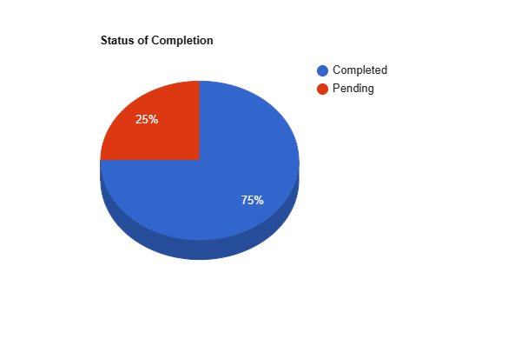
Status of Completion

Slide 12
Challenges Faced
Taking input into 3 coordinates
Resolved by using map and split functions
Printing output in specific format
Used string formatting
Calculating radius of balloon by satisfying all conditions
Used numpy

Slide 13
References
https://docs.python.org/3/
Department of Computer Science and Engineering

Slide 14
THANK YOU

